Slide 1
Overview of Analysis
Analysis is an iterative process… make a ‘first cut’ conceptual model and then iteratively refine it as your understanding of the problem increases.
Steps in the analysis process
  1. Identifying the classes
  2. Identifying the classes attributes and responsibilities
  3. Identifying relationships and collaborations between classes

Slide 2
Couple of rules
Good classes provide adequate encapsulation
Responsibilities should be well distributed among all classes (there should not be one main class that does almost everything)

Slide 3
Case Study: A Resort Reservation System
Design the software to handle reservations at Blue Lake Resort. The resort comprises several cottages and two meeting rooms. Cottages can comprise from one to three beds. The first meeting room has a capacity of 20 persons, the second, 40 persons. Cottages can be booked by the night; meeting rooms can be booked by the hour. Rates for cottages are expressed per person, per night; rates for meeting rooms are expressed per hour.

Slide 4
Case Study: A Resort Reservation System
Clients can book cottages and meeting rooms in advance by providing a phone number and a valid credit card information. Customers can express preferences for specific cottages. Cancellation of reservations is possible but requires 24 hours notice. An administrative charge applies to all cancellations. Every morning, a summary of the bookings for the previous day is printed out and the related information is erased from the computer; a list of the cottages and meeting rooms that will require cleaning is printed.

Slide 5
Noun Identification Approach
Identify candidate classes by extracting all nouns out of the requirements/ specifications of the system.
Steps:
Identify Nouns / Nouns Phrases from the SRS
Ignore [Cut] the Attribute Nouns
Identify Redundant Nouns and Select Only One
Apply Adjectives To The Existing Nouns
In the End, Write a Statement of Purpose for Each Remaining Noun Class [Ignore the Noun For which you are not able to write any statement of purpose]

Slide 6
Noun identification: Case Study
Design the software to handle reservations at Blue Lake Resort. The resort comprises several cottages and two meeting rooms. Cottages can comprise from one to three beds. The first meeting room has a capacity of 20 persons, the second, 40 persons. Cottages can be booked by the night; meeting rooms can be booked by the hour. Rates for cottages are expressed per person, per night; rates for meeting rooms are expressed per hour.

Slide 7
Noun identification: Case Study
Clients can book cottages and meeting rooms in advance by providing a phone number and a valid credit card information. Customers can express preferences for specific cottages. Cancellation of reservations is possible but requires 24 hours notice. An administrative charge applies to all cancellations. Every morning, a summary of the bookings for the previous day is printed out and the related information is erased from the computer; a list of the cottages and meeting rooms that will require cleaning is printed.

Slide 8
Keeping the right candidate classes
Having made a tentative list of classes, eliminate unnecessary or incorrect classes according to the following criteria:
Redundant classes: nouns that express the same information
Irrelevant classes: nouns that have nothing to do with the problem
Vague classes: nouns with ill-defined boundaries or which are too broad
Attributes: nouns referring to something simple with no interesting behavior, which is simply an attribute of another class
Events or operations: nouns referring to something done to the system (sometimes events or operations are to be kept: check if they have state, behavior and identity).
Outside the scope of the system: nouns that do not refer to something inside the system

Slide 9
Refined list: Case Study
Good classes: Cottage, Meeting Room, Client
Bad classes: Software, Blue Lake Resort, Bed, Capacity, Night, Hour, Rate, Phone number, Credit Card Information,, Preference, Notice, Administrative Charge, Morning, Day, Information, Computer
Don’t know: Reservation, Resort, Summary, List

Slide 10
More Class Identification Tips
Adjectives can suggest different kinds of objects or different use of the same object. If the adjectives indicate different behavior then make a new class.
Be wary of sentences in the passive voice, or those whose subjects are not part of the system. Recast the sentence in the active voice and see if it uncovers other classes. e.g.: "a summary of the bookings for the previous day is printed out". Missing from this sentence is the subject or who is doing the printing.

Slide 11
More Class Identification Tips
Keeping two lists (strong candidates and weaker ones) is a useful technique to avoid losing information while still sorting between things you are sure about and things that have yet to be settled. Additional techniques in Step 2 (identifying responsibilities and attributes) and Step 3(identifying relationships and attributes) will help.

Slide 12
Relationships
Association : An Association is a bi-directional connection between classes (e.g. the "hires/works for" relationship between an "employee" class and a "boss" class). It is represented by a solid line. This line can be qualified with the type of relationship, and can also feature multiplicity rules (eg. one-to-one, one-to-many, many-to-many) for the relationship.

Slide 13
Relationships
Aggregation: Aggregations indicate a whole-part relationship, and are known as "has-a" relationships. An aggregation is represented as a line connecting the related classes with a diamond next to the class representing the whole.

Slide 14
Relationships
Composition: If a class cannot exist by itself, and instead must be a member of another class, then that class has a Composition relationship with the containing class. A Composition relationship is indicated by a line with a filled diamond.

Slide 15
Relationships
Dependency: When a class uses another class, perhaps as a member variable or a parameter, and so "depends" on that class, a Dependency relationship is formed. A Dependency is a relationship where the client does not have semantic knowledge of the supplier. It can be used, for example to show the relationship between an "encoder" class and a "generic Algorithm" class that is inserted in runtime to help it encode a stream. A dependency is shown as a dashed line pointing from the client to the supplier.

Slide 16
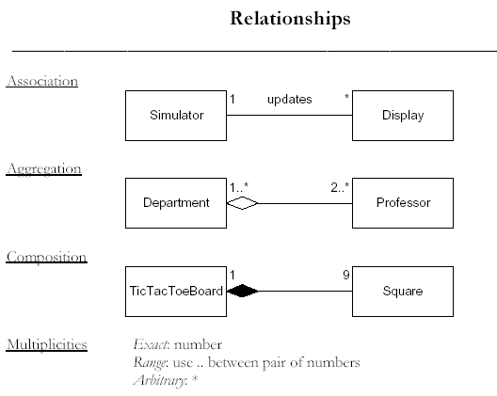
Relationships

Slide 17
Class notation
A class diagram exhibits classes and their
associations used in an application.
Contrast this with a conceptual model which
shows domain concepts and their associations.
ClassName
attributes
methods
A class
Note: you can include visibility attributes: + for public, – for private, # for protected

Slide 18
Class Diagrams
A class diagram is a visual representation of various classes and their relationships as identified during design.
The class diagram is core to object-oriented design.
Class diagrams identify the class structure of a system, including the properties and methods of each class.
It describes the types of objects in the system and the static relationships between them, such as an inheritance relationship.

Slide 19
Building a class diagram
Once the interaction diagrams have been completed it is possible to identify the specification for the software classes and interfaces.
The UML has notation to define design details in static structure, or class diagrams.
Conceptual model is also useful in deriving classes by addition of detail.
A class diagram differs from a domain model by showing software entities rather than real-world concepts.

Slide 20
Building a class diagram (cont.)
Typical information in a class diagram includes:
  Classes, associations and attributes
  Interfaces (with operations and constants)
  Attribute type information
  Methods
  navigability
  dependencies
The class diagram depends upon the domain model and interaction diagrams.

Slide 21
Making class diagrams (1)
Identify all classes by examining interaction diagrams.
Draw them in a class diagram.
Duplicate the attributes from the associated concepts shown in the conceptual model.
Add method names by examining interaction diagrams.
Add type information to the attributes and methods.

Slide 22
Making class diagrams (2)
Add the associations needed for visibility.
Add navigability arrows to indicate the direction of attribute visibility.
Add dependency relationships to indicate non-attribute visibility.

Slide 23
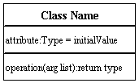
Classes
Classes are the building blocks in object-oriented programming. Illustrate classes with rectangles divided into compartments. Place the name of the class in the first partition (centered, bolded, and capitalized), list the attributes in the second partition, and write operations into the third.

Slide 24

Active Class
Active classes initiate and control the flow of activity, while passive classes store data and serve other classes. Illustrate active classes with a thicker border.

Slide 25
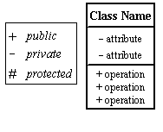
Visibility
Use visibility markers to signify who can access the information contained within a class. Private visibility hides information from anything outside the class partition. Public visibility allows all other classes to view the marked information. Protected visibility allows child classes to access information they inherited from a parent class.

Slide 26
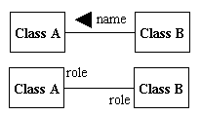
Associations
Associations represent static relationships between classes. Place association names above, on, or below the association line. Use a filled arrow to indicate the direction of the relationship. Place roles near the end of an association. Roles represent the way the two classes see each other.
Note:It's uncommon to name both the association and the class roles.

Slide 27
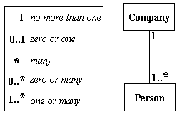
Multiplicity (Cardinality)
Place multiplicity notations near the ends of an association. These symbols indicate the number of instances of one class linked to one instance of the other class. For example, one company will have one or more employees, but each employee works for one company only.

Slide 28
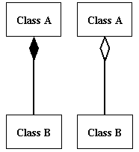
Composition and Aggregation
Composition is a special type of aggregation that denotes a strong ownership between Class A, the whole, and Class B, its part. Illustrate composition with a filled diamond.
Use a hollow diamond to represent a simple aggregation relationship, in which the "whole" class plays a more important role than the "part" class, but the two classes are not dependent on each other. The diamond end in both a composition and aggregation relationship points toward the "whole" class or the aggregate.

Slide 29
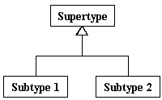
Generalization
Generalization is another name for inheritance or an "is a" relationship. It refers to a relationship between two classes where one class is a specialized version of another. For example, Honda is a type of car. So the class Honda would have a generalization relationship with the class car.

